Slide 1

Average/Instantaneous Velocity/Acceleration,
Uniform Circular Motion
Chapter 4: Motion in Two and Three Dimensions
RIMSHA Bashir Awan
FAST-National University of Computer and Emerging Sciences

Slide 2
Outline
Position
Displacement
Average Velocity and Instantaneous Velocity
Average Acceleration and Instantaneous Acceleration
Projectile Motion
Horizontal Motion
Vertical Motion
Equation OF Path
Horizontal Range
Uniform Circular Motion

Slide 3
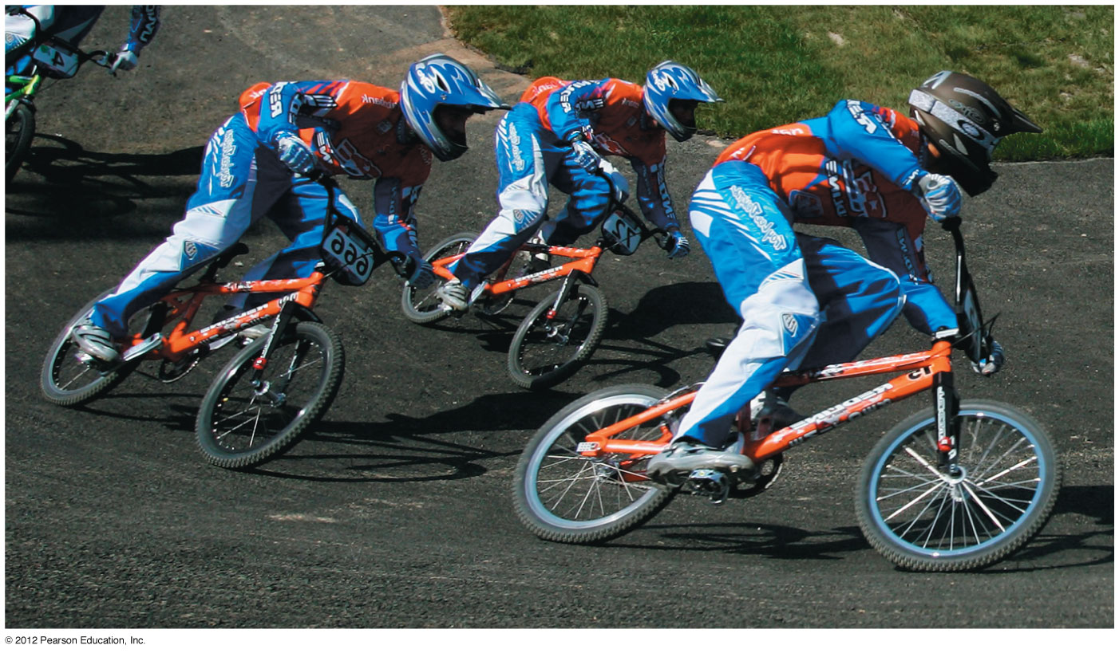
Introduction
What determines where a batted baseball lands?
If a cyclist is going around a curve at constant speed, is he accelerating?
We need to extend our description of motion to two and three dimensions.

Slide 4
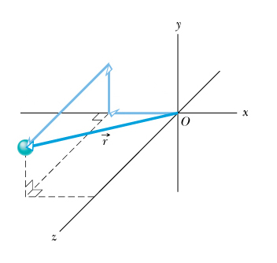
Position
The position of an object is described by its position vector,

Slide 5
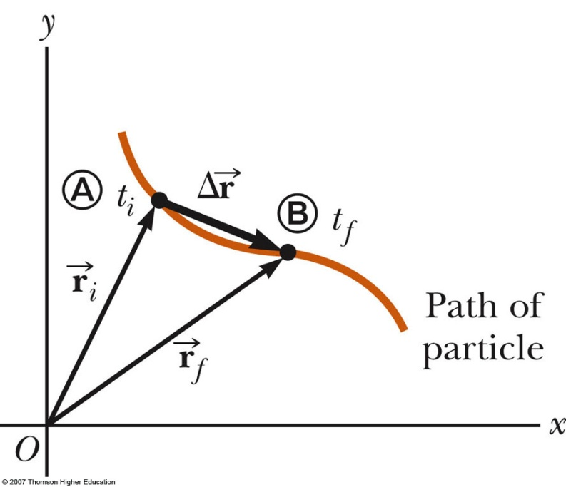
Displacement
The displacement vector is defined as the change in its position,

Slide 6
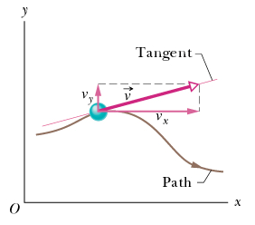
Velocity
Average velocity
Instantaneous velocity

Slide 7
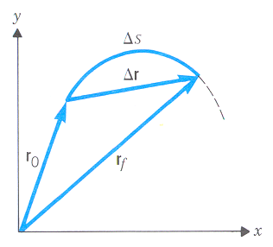
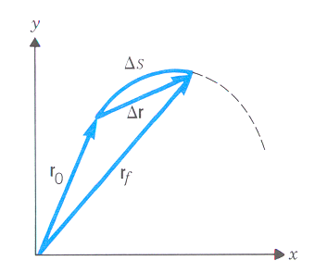
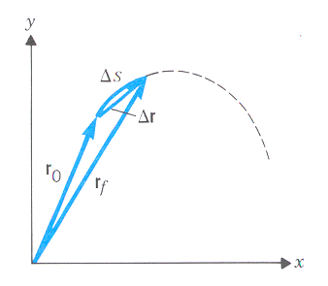
Instantaneous velocity
Vector of instantaneous velocity is always tangential to the object’s path at the object’s position

Slide 8
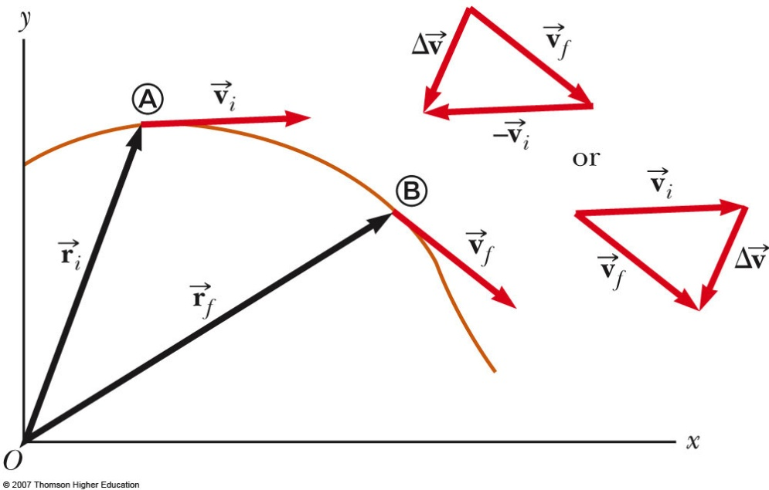
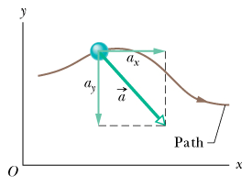
Acceleration
Average acceleration
Instantaneous acceleration

Slide 9
Projectile motion
A special case of 2D motion
An object moves in the presence of Earth’s gravity
We neglect the air friction and the rotation of the Earth
As a result, the object moves in a vertical plane and follows a parabolic path
The x and y directions of motion are treated independently

Slide 10
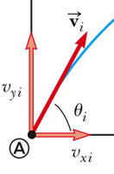
Projectile motion – X direction
A uniform motion: a_{x} = 0
Initial velocity is
Displacement in the x direction is described as

Slide 11
Projectile motion – Y direction
Motion with a constant acceleration: a_{y} = – g
Initial velocity is
Therefore
Displacement in the y direction is described as

Slide 12
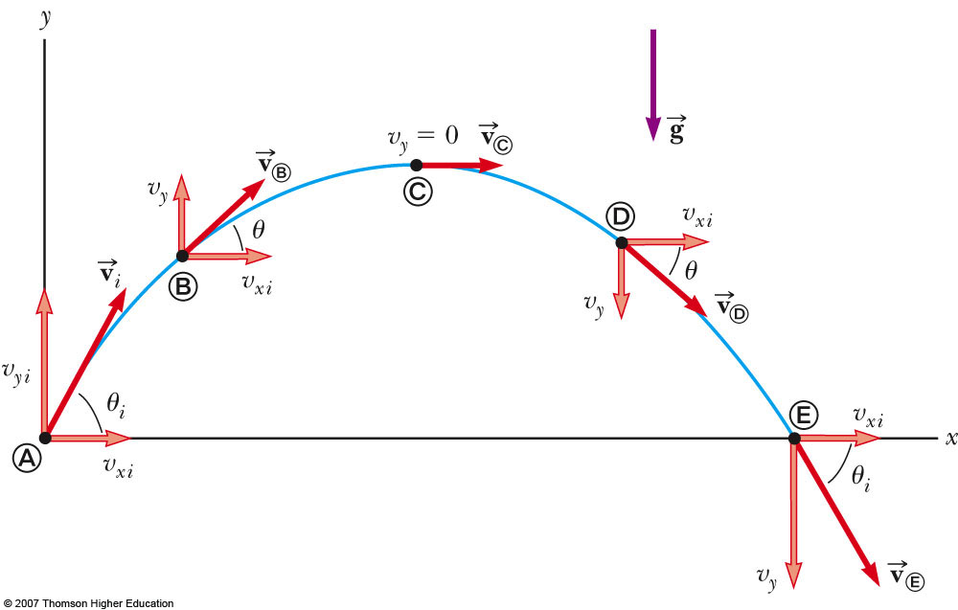
Projectile motion: putting X and Y together

Slide 13
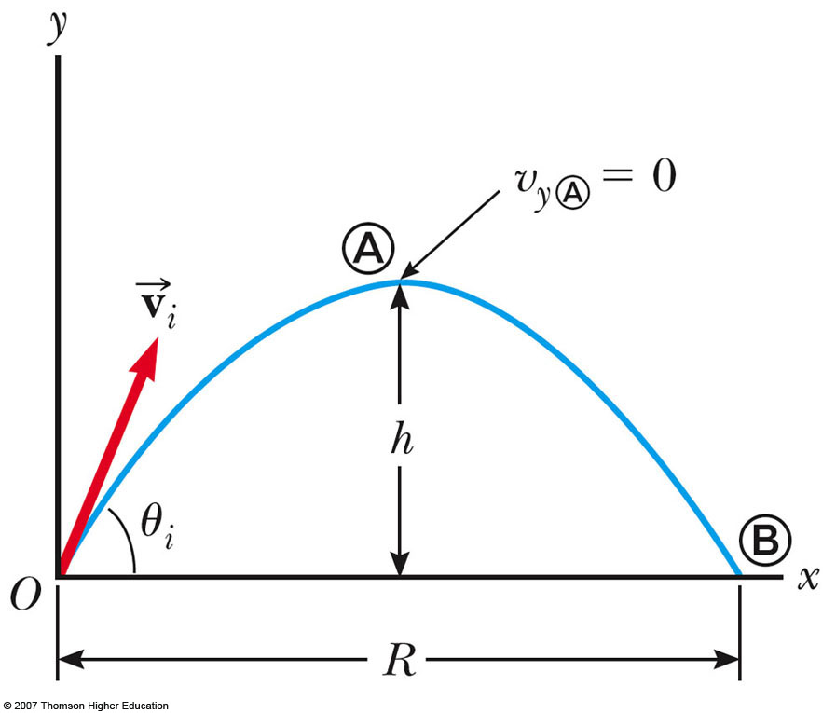
Projectile motion: trajectory and range

Slide 14
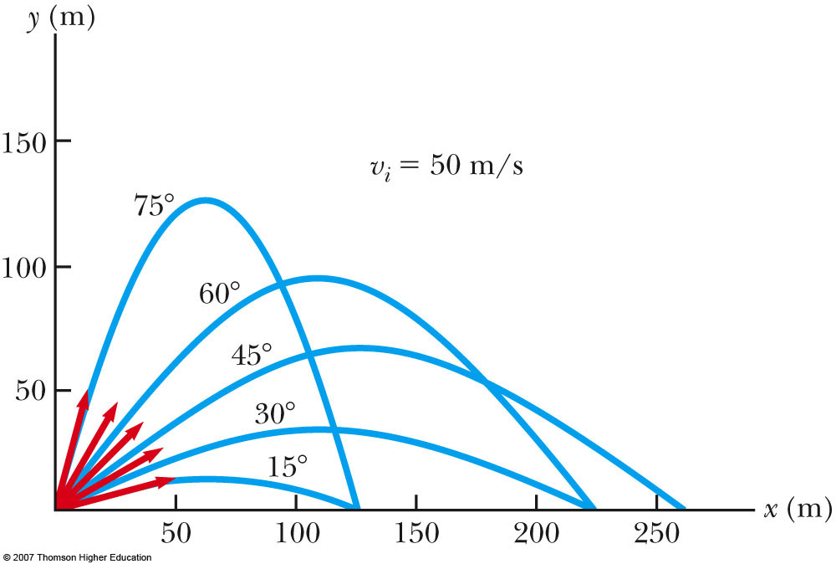
Projectile motion: trajectory and range

Slide 15
Chapter 4
Problem
A carpenter tosses a shingle horizontally off an 8.8-m-high roof at 11 m/s. (a) How long does it take the shingle to reach the ground? (b) How far does it move horizontally?

Slide 16
Uniform circular motion
A special case of 2D motion
An object moves around a circle at a constant speed
Period – time to make one full revolution
The x and y directions of motion are treated independently

Slide 17
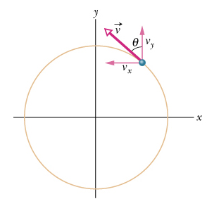
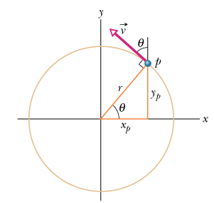
Uniform circular motion
Velocity vector is tangential to the path
From the diagram
Using
We obtain

Slide 18
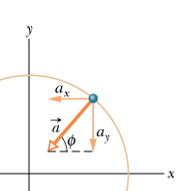
Centripetal acceleration

Slide 19
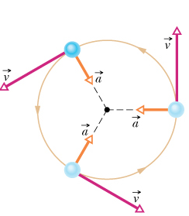
Centripetal acceleration
During a uniform circular motion:
the speed is constant
the velocity is changing due to centripetal (“center seeking”) acceleration
centripetal acceleration is constant in magnitude (v²/r), is normal to the velocity vector, and points radially inward

Slide 20
Chapter 4
Problem
How fast would a car have to round a 75-m-radius turn for its acceleration
to be numerically equal to that of gravity?

Slide 21
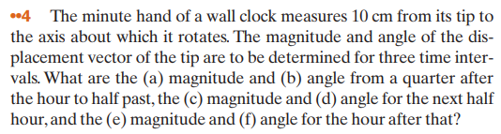
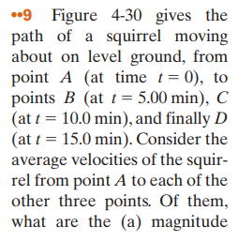
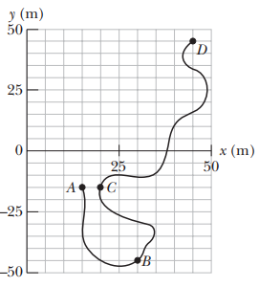
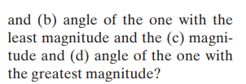

Slide 22
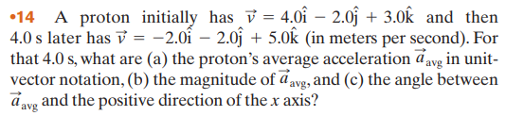



Slide 23
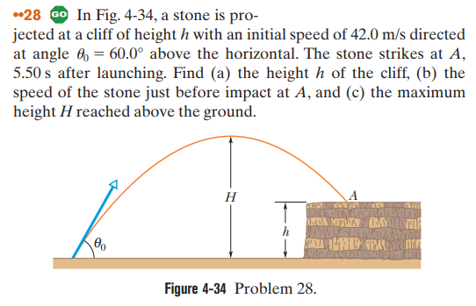

Slide 24
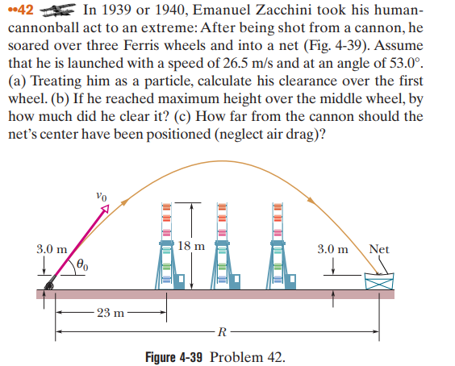

Slide 25
